Slide 1
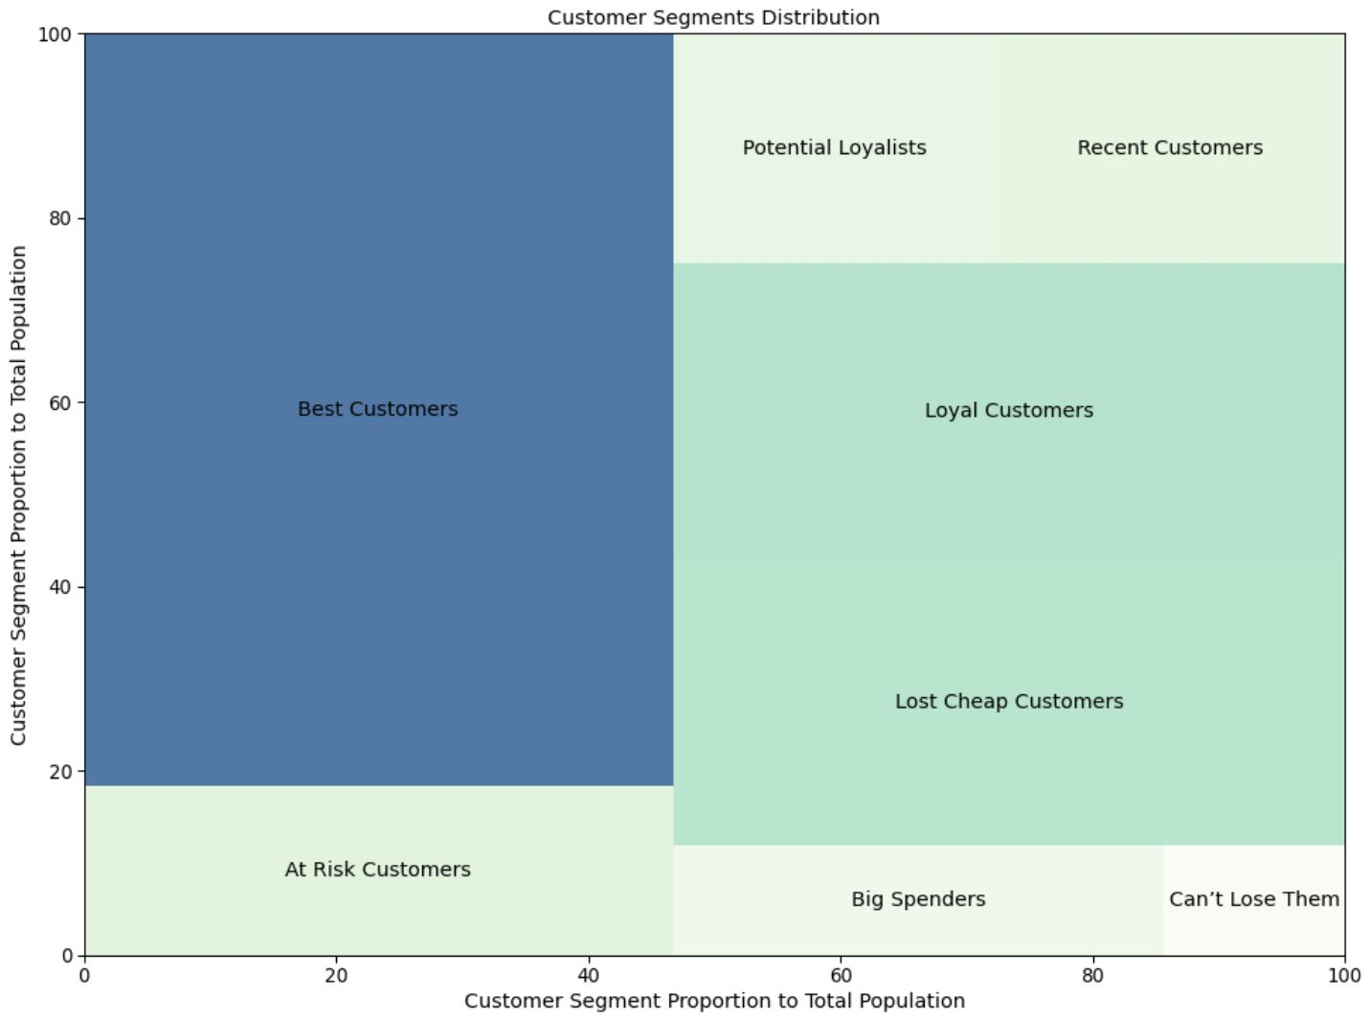
Online Retail Customer Segmentation
The UK-based online retail customer transactional dataset (01/12/2010 – 09/12/2011), published by Manish Kumar on the open source platform Kaggle, was used to identify high-value customers among 2,509 customers in total by examining how recently a customer has purchased (recency), how often they purchase (frequency), and how much the customer spends (monetary).
The Recency (R) score range is from 4 to 1, representing values from 373 days to 0 day.
The Frequency (F) score range is from 1 to 4, representing values from 1 to 7,812 times.
The Monetary (M) score range is from 1 to 4, representing values from - € 4,288 to € 279,489.
The treemap below shows the distribution of 8 customer segments. The area represents the proportion of each customer segment, while the color represents the range of RFM total score (from 3 to 12) of each customer segment, with the highest score in dark blue and the lowest score in light green.
Customer Segments | Customer Counts | Percentage | Customer Segment Description
Best Customers | 444 | 17.7% | Highest frequency as well as monetary value with least recency
Loyal Customers | 344 | 13.7% | High frequency as well as monetary value with good recency
Potential Loyalists | 434 | 17.3% | High recency and monetary value, average frequency
Big Spenders | 334 | 13.3% | High monetary value but good recency and frequency values
At Risk Customers | 244 | 9.7% | Customer’s shopping less often now who used to shop a lot
Can’t Lose Them | 144 | 5.7% | Customer’s shopped long ago who used to shop a lot
Recent Customers | 443 | 17.7% | Customer’s who recently started shopping a lot but with less monetary value
Lost Cheap Customers | 122 | 4.9% | Customer’s shopped long ago but with less frequency and monetary value
Data Source: Kumar, Manish. “Online Retail K-Means & Hierarchical Clustering.” Kaggle, 26 Oct. 2019, www.kaggle.com/hellbuoy/online-retail-customer-clustering.

